Slide 1

Comparing Mutual
Information in Finite
Samples
Can MI-specific degrees of freedom improve comparisons between populations?
Daniel Zhao (Master of Computer Science)
Supervisor: Associate Professor Joseph T. Lizier
The University of Sydney
Notes:
Time: 0:25 (finish by 0:25)
SCRIPT
This project asks whether mutual information differs between populations when we have finite samples. I derive MI-specific degrees of freedom for a Welch–Satterthwaite comparison, then examine when its larger rejection cutoff improves false-positive accuracy and what happens to power.
TRANSITION
“The comparison starts with two populations and a sample from each.”
DELIVERY CUE
Face the audience. Use the question rather than reading the affiliation.
SOURCE
Final title, abstract, and Chapter 1; preferred-reference page 1.

Slide 2
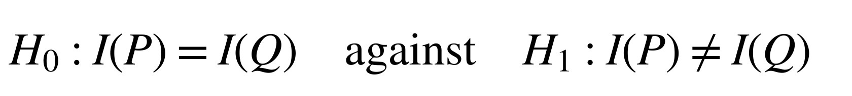
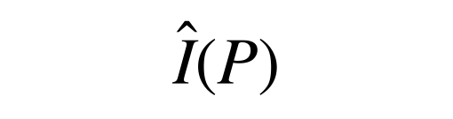
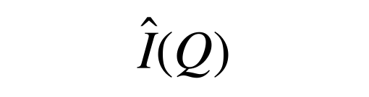
Motivation: comparing MI across populations
Mutual information measures how much observing one variable reduces uncertainty about another, on average. Different sample estimates can arise from sampling noise.
Hypotheses
$$H_{0}:I\left(P\right)=I\left(Q\right) \text{against} H_{1}:I\left(P\right)≠I\left(Q\right)$$
Two populations
Statistical task
Population P
sample size 𝑛_{𝑃}
MI estimate
Summarise a sample from each population in a count table
$$\hat{I}\left(P\right)$$
Estimate MI from each table
Population Q
sample size 𝑛_{𝑄}
MI estimate
$$\hat{I}\left(Q\right)$$
Assess whether sampling noise can explain the difference
Variables: two categorical variables, 𝑋 and 𝑌.
Does MI differ between the two populations?
Table icons are schematic. Thesis Sections 1.1 and 2.1; Bossomaier et al. (2016)
2
Notes:
Time: 1:15 (finish by 1:40)
SCRIPT
Mutual information measures the average reduction in uncertainty about one variable when we observe another. I compare that association between two populations, whose probability tables I call P and Q.
We observe a sample from each population, summarise it in a count table, and estimate MI from each table. Different samples can produce different estimates even when population MI is equal. The null hypothesis therefore equates the two population MI values, against the two-sided alternative that they differ. It allows different probability tables. We need to account for sampling uncertainty before interpreting an observed difference.
TRANSITION
“The literature supplies several parts of that comparison, with one additional MI-specific calculation needed.”
DELIVERY CUE
Trace each population into its estimate, then point to the null.
SOURCE
Thesis Sections 1.1 and 2.1; Bossomaier et al. (2016).

Slide 3
Literature review: foundations and the MI-specific step
Existing results provide MI estimates, a Wald test using a standard normal distribution, and moment matching.
This project derives the MI variance sensitivity needed for its degrees of freedom.
 | MI estimation and uncertainty | Wald comparison | Welch–Satterthwaite moment matching
Idea | Estimate MI and first-order sampling variance | Divide the estimated difference by its standard error | Match variance moments to choose degrees of freedom
Key work | Moddemeijer (1989); Paninski (2003) | Wald (1943); Mora and Ruiz-Castillo (2009) | Satterthwaite (1946); Welch (1947); Hutcheson (1970); Pan and Wall (2002)
Required step | Track variation in the variance estimate itself | Assess the fixed cutoff from the standard normal distribution in finite samples | Calculate the MI-specific variance sensitivity
Contribution: Derive that sensitivity and evaluate the resulting degrees of freedom.
Thesis Sections 2.2–2.5 and 3.2–3.3; full references in B13–B14
3
Notes:
Time: 1:00 (finish by 2:40)
SCRIPT
The project builds on three established strands. Work on MI supplies the estimator, its leading bias correction, and its first-order sampling variance. The Wald test uses those estimates with the standard normal distribution as its reference. Welch and Satterthwaite instead use variance moments to choose degrees of freedom, with related applications in entropy and other statistical comparisons.
For this MI comparison, the additional calculation is how much the pointwise-MI variance estimate changes when the sampled table changes. Its probability weights, row and column margins, and pointwise-MI values all change together. I derive that sensitivity and evaluate the resulting approximation.
TRANSITION
“The two tests then share a statistic but use different reference distributions.”
DELIVERY CUE
Move across the columns once. Emphasise the required calculation rather than reciting authors.
SOURCE
Thesis Sections 2.2–2.5 and 3.2–3.3; bibliography keys moddemeijer1989, paninski2003, mora2009, satterthwaite1946, welch1947, hutcheson1970, and panwall2002.

Slide 4


Method: one statistic, two reference distributions
Both methods use the same estimated MI difference and standard error.
Expanded Welch uses estimated degrees of freedom for a Student t distribution.
Shared statistic
$$T=\frac{{\hat{Δ}}_{BC}}{\hat{SE}}, {\hat{SE}}^{2}=\frac{\hat{V}\left(P\right)}{n_{P}}+\frac{\hat{V}\left(Q\right)}{n_{Q}}$$
Δ̂_{BC}: estimated 𝐼(𝑃) − 𝐼(𝑄), after leading bias correction.
𝑉(𝑃): population variance of pointwise MI;
𝑉̂(𝑃) estimates it from one sampled table.
Wald test
Standard normal distribution; two-sided 5% cutoff about ±1.96.
Expanded Welch test
Student t distribution with estimated degrees of freedom; a larger cutoff.
Student t distribution with 5 degrees of freedom, for illustration; cutoff about ±2.57.
Thesis Chapters 3–4, Figure 2.1. Calculation requirements: Slide 6 and B3
4
Notes:
Time: 1:20 (finish by 4:00)
SCRIPT
Both tests divide the corrected MI difference by the same estimated standard error. Pointwise MI is the information contribution of one category pair. V-hat estimates its variance, and dividing by sample size estimates the sampling variance of an MI estimate. Independence between the samples lets their two variance contributions add.
The Wald test compares the statistic with the standard normal distribution. The Expanded Welch test uses a Student t distribution with degrees of freedom estimated from the tables. The illustration uses five degrees of freedom: its heavier tails move the two-sided cutoff from about 1.96 to 2.57. Actual estimated values vary. The larger cutoff means Expanded Welch's rejections are a subset of Wald's under the implemented rules. The experiments assess whether that reduction helps accuracy and how much detection it costs.
TRANSITION
“Choosing the degrees of freedom requires the variability of the variance estimate itself.”
DELIVERY CUE
Point to the common denominator, then cutoffs. Do not imply the illustrated difference is typical of every dataset.
SOURCE
Thesis Chapters 3–4 and Figure 2.1; quantiles of the standard normal distribution and the Student t distribution with 5 degrees of freedom.

Slide 5
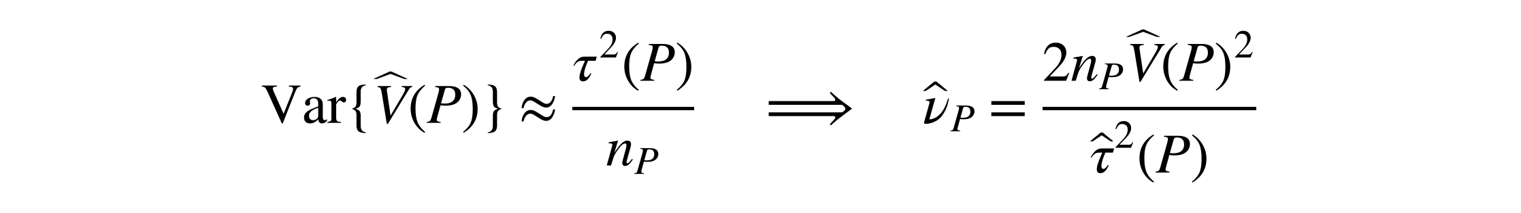
Approach and contribution
The estimated pointwise-MI variance changes between samples.
We approximate that variation and use it to choose the degrees of freedom.
Derivation chain
Cell probabilities change
Move a small amount of probability towards one cell.
Margins and pointwise MI change
Track their joint effect.
Variance sensitivity, derived here
𝑔_{𝑃}(𝑥, 𝑦) describes the change in 𝑉(𝑃).
Degrees of freedom
Use the spread of those sensitivities.
Result and approximations
$$Var\{\hat{V}\left(P\right)\}≈\frac{τ^{2}\left(P\right)}{n_{P}} ⇒ {\hat{ν}}_{P}=\frac{2n_{P}\hat{V}{\left(P\right)}^{2}}{{\hat{τ}}^{2}\left(P\right)}$$
Two approximations evaluated
1
First-order sampling expansion
𝜏²(𝑃) is the variance of 𝑔_{𝑃}(𝑋, 𝑌). Repeat for Q and combine using Welch–Satterthwaite.
2
Matching a scaled chi-squared distribution
Thesis Sections 4.1–4.3; exact derivative in B1, moment matching in B2
5
Notes:
Time: 2:05 (finish by 6:05)
SCRIPT
There are two levels of variation. V-hat describes variation in pointwise MI, but V-hat itself changes when a new sample produces a different table. I calculate how V changes when a small amount of probability moves towards one cell. That perturbation changes the cell weights, margins, and log ratios together. The sensitivity g collects those effects.
Averaging observation-level sensitivities gives a first-order approximation to the sampling error of V-hat. Its sampling variance is therefore approximately tau-squared divided by sample size. Satterthwaite moment matching uses twice the squared mean of a variance estimate divided by its sampling variance. Substituting the sample-based inputs gives the component formula shown here. Greater variation relative to the squared mean gives fewer degrees of freedom. I repeat the calculation for Q and combine the components.
The derivative is an exact calculation for positive population tables. Its sampling expansion and the moment-matched Student t distribution are approximations, which motivates the first evaluation question.
TRANSITION
“Known population tables let me check those approximations before assessing test decisions.”
DELIVERY CUE
Pause between V-hat and its sampling variance. Explain the chain before the formula. The displayed df are component df, not the combined test df.
SOURCE
Thesis Sections 4.1–4.3; eq:g-final, eq:vhat-sampling-variance, eq:nu-p-hat, and eq:expanded-df. B1–B2 retain the full derivative and moment-matching argument.

Slide 6
Evaluation design
Known populations separate approximation accuracy, false positives, and power.
Both tests receive the same sampled table pairs.
Research questions
Shared simulation grid
Four sizes: 2×2, 4×4, 8×8, 16×16
Uniform, same-skew, and different-skew margins
Ten sample sizes: 10 to 50,000 observations per population
360 settings per study (4 sizes × 3 margins × 10 sample sizes × 3 MI levels or gaps)
100,000 independent table pairs per setting
Model: a copying construction that fixes the margins and solves for the target MI.
1
RQ1: Approximation accuracy
Sampling moments of 𝑉̂ and component df, including near independence
2
RQ2: False positives
Equal MI at 0.005, 0.02, and 0.30 nats
3
RQ3: Power
𝐼(𝑃) = 0.02; MI-gap magnitudes 0.005, 0.01, and 0.02 nats
Reporting: usual 0.05 p-value thresholds. Unsuccessful calculations count as non-rejections; calculation success is reported separately.
Morris et al. (2019). Thesis Chapter 5, Tables 5.1–5.3; exact vectors, sample sizes, and requirements in B3
6
Notes:
Time: 1:20 (finish by 7:25)
SCRIPT
I construct population tables with known MI using a copying model that preserves chosen margins. RQ1 checks the variance approximations and the resulting degrees of freedom. The null study uses three shared MI values, while power fixes MI in P at 0.02 nats and makes Q larger by three gaps. Nats are MI units based on natural logarithms.
Both test studies cross four table sizes, ten sample sizes, and three margin regimes, giving 120 combinations for each MI level or gap. With three levels or gaps, each study has 360 settings. The uneven margins either agree between populations or differ. Every test sees only its two sampled tables. Repeating the comparison 100,000 times measures performance without increasing the observations available to one test. Both methods use the same pairs and usual p-value thresholds. Unsuccessful calculations count as non-rejections, with calculation success tracked separately.
TRANSITION
“The first result shows why accurate variance prediction can coexist with an inflated mean.”
DELIVERY CUE
Name what varies and stays fixed. Do not recite ten sample sizes or restore fitted-threshold experiments.
SOURCE
Thesis Chapter 5, Tables 5.1–5.3, and Appendix B; Morris et al. (2019). Current balanced-null and MI-gap grids.

Slide 7

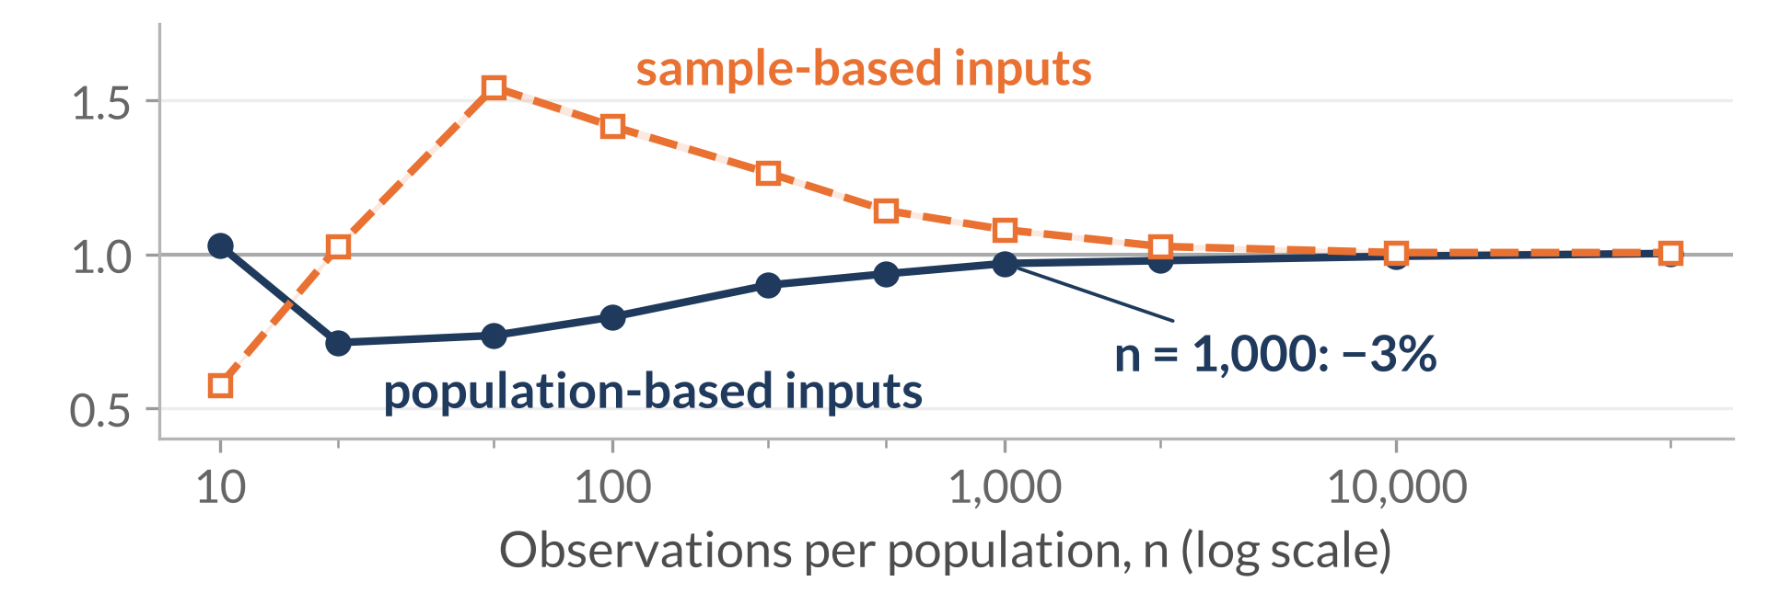
RQ1 results: approximation accuracy
The mean of 𝑉̂ can remain inflated even when its population first-order sampling-variance prediction is accurate.
Mean of 𝑉̂ / population 𝑉
Different-skew P · 4×4 · population MI 0.02 nats
Mean: rare cells can inflate it.
Newly observed rare cells can have large pointwise-MI deviations, whose squares raise 𝑉̂.
Sampling variance: linearisation can miss large changes.
Rare cells appear in some samples and not others;
sample-based sensitivities can also overpredict the resulting variation.
Predicted / observed sampling variance of 𝑉̂
At n = 1,000: mean 19% high;
variance prediction 3% low with population-based inputs
and 8% high with sample-based inputs.
Both moments enter the degrees of freedom.
Thesis Sections 6.1.1–6.1.2, Figures 6.1–6.2. Bands: approximate 95% Monte Carlo intervals. Other sizes and Q: B4
7
Notes:
Time: 1:40 (finish by 9:05)
SCRIPT
This is one population and a four-by-four table, so the two moment errors can be read together. On top, one would mean the average V-hat equals the population variance. The mean rises above that benchmark and then recovers. When rare cells first appear, their estimated pointwise MI can lie far from the table's MI. The squared deviations can inflate V-hat until repeated counts stabilise the estimates.
The lower graph concerns the sampling variance of V-hat itself. The navy curve uses known population inputs; the orange curve estimates those inputs from each sample. The population prediction misses variation when rare cells appear in some samples and remain absent in others. Estimating the sensitivities from sparse counts can instead overshoot. Larger samples improve both predictions.
At one thousand observations, the population prediction is about three percent low, while the sample-based prediction is about eight percent high. The mean is still nineteen percent high. Since the degrees-of-freedom calculation squares the mean input and divides by the variance input, a good variance prediction alone does not make that calculation accurate.
TRANSITION
“Near independence, an additional separation appears because sampling noise creates apparent association.”
DELIVERY CUE
Pause when the graphs appear. Explain the top graph before the bottom. Say “sampling variance of V-hat”. Tie both annotations to n=1,000.
SOURCE
Thesis Sections 6.1.1–6.1.2, Figures 6.1–6.2; null-display IDs, side=p, k=4, profile=different_skew, MI=.02. B2 retains the numerical df consequence of this same example.

Slide 8
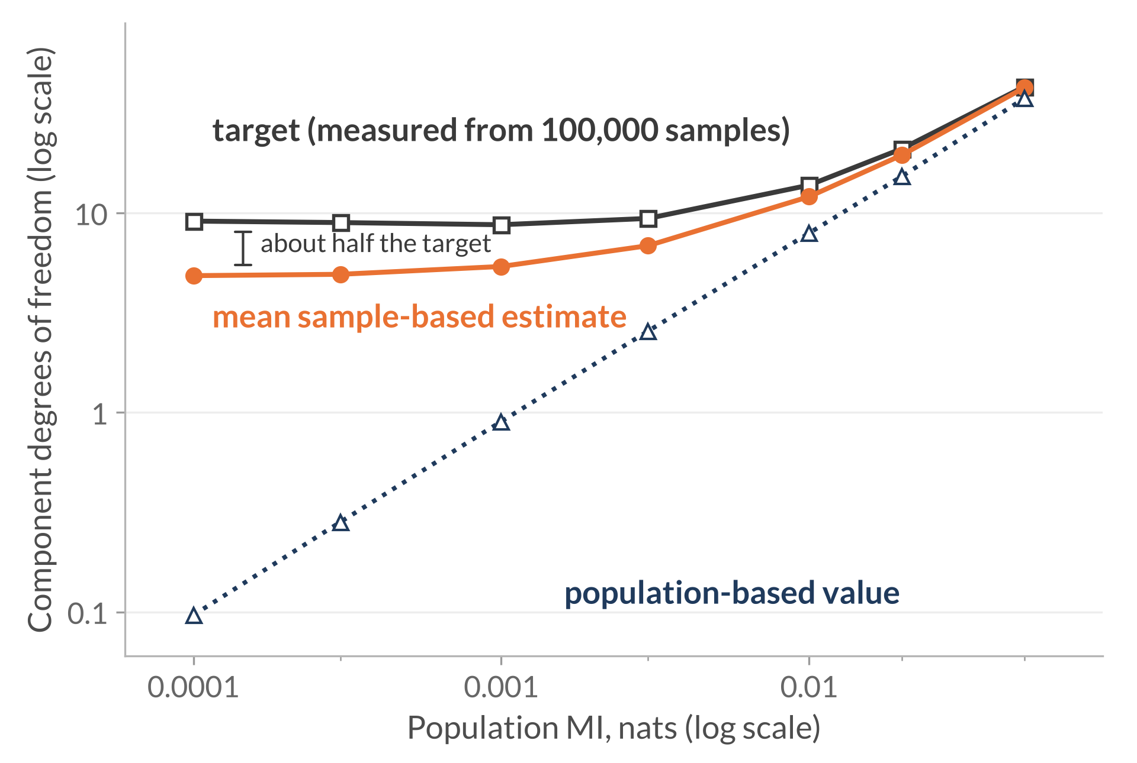
RQ1 results: near independence
Near independence, first-order theory gives almost no degrees of freedom, while
sampling noise keeps the mean sample-based estimate at about half the target.
Different-skew P · 4×4 · n = 1,000 fixed
Population-based: falls to about n × MI
Inserts known population inputs into the first-order formula. Near independence it is about n × population MI, which heads to zero.
Sample-based: noise keeps it near 5
Quadratic sampling errors create apparent association, which remains in each sample’s calculation.
At MI 0.0001: target ≈9.1;
mean sample-based estimate ≈4.9;
population-based value ≈0.1
Target: component degrees of freedom from the actual mean and variance of 𝑉̂ across 100,000 samples.
Thesis Section 6.1.3, Figure 6.3; Appendix A.2. Lines: target 𝜈_{𝑃,mom}, mean of 𝜈̂_{𝑃}, population-based 𝜈_{𝑃,FO}. Bands: approximate 95% Monte Carlo intervals. Local calculation: B5
8
Notes:
Time: 2:00 (finish by 11:05)
SCRIPT
Here sample size stays at one thousand while population MI approaches zero. The dotted navy line is the population-based value: it inserts known population inputs into the first-order component formula and becomes very small. The orange line is the sample-based estimate, the mean component degrees of freedom estimated from sampled tables. It stays near five at the weakest association. The charcoal target is the component degrees of freedom calculated from the actual mean and variance of V-hat across the repeated samples. It is near nine, so the sample-based estimate is only about half the target.
At independence, population pointwise MI is zero and the linear sampling contribution vanishes. Sampled tables nevertheless contain apparent association from quadratic sampling errors. The sample-based calculation retains that noise, which explains why its mean stays positive instead of following the population-based value towards zero. The local calculation in the thesis predicts a mean near 4.6 here, against the observed 4.9. This explains the separation while also showing the limits of the first-order approximation.
TRANSITION
“The decision-level question is whether the larger cutoff brings false positives towards five percent.”
DELIVERY CUE
Pause when the graph appears. Point to the low-MI end and explain each curve once. Preserve this slide in every shorter route. The calculation does not prove an exact Student t distribution.
SOURCE
Thesis Section 6.1.3, Figure 6.3, and Appendix A.2; observed mean 4.859787, target 9.124808, and first-order value .096400.

Slide 9
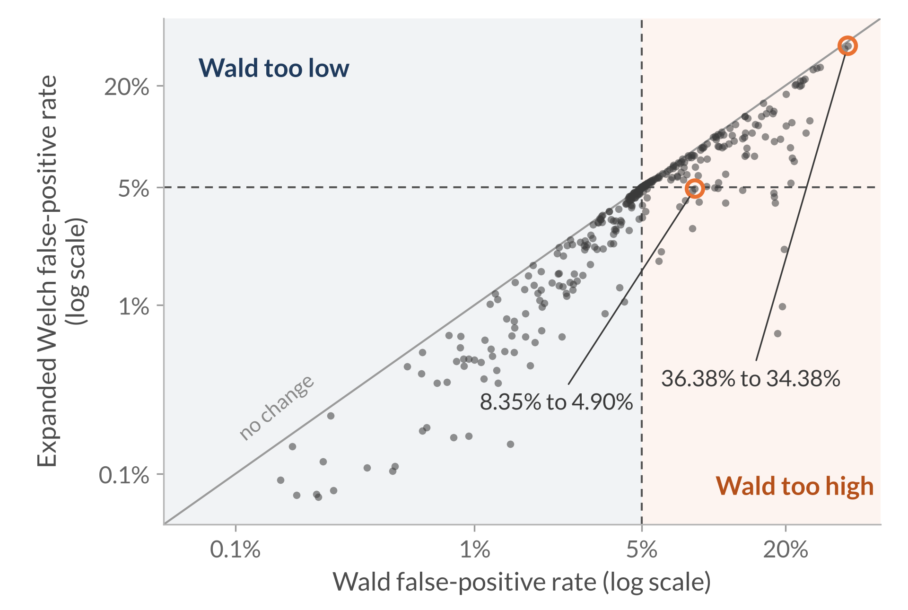
RQ2 results: false positives across all null settings
A larger cutoff helps only where Wald rejects too often;
where Wald already rejects too rarely, it never brings the rate closer to 5%.
All 360 null settings · equal MI in P and Q · each point is one setting
Wald too high: 178 settings
Expanded Welch moves closer to 5% in 165, for example 8.35% to 4.90% (uniform 4×4, n = 20, MI 0.02).
Wald too low: 180 settings
Further below 5% in 176 settings; unchanged in four.
Descriptive 4–6% band: 130 versus 136 settings.
Bias-driven excess persists: 36.38% to 34.38%
(different-skew 16×16, n = 1,000, MI 0.005).
Below the diagonal: Expanded Welch rejects less often. Dashed lines: the 5% target.
Tallies of the thesis null study (Sections 6.2.1–6.2.3, Figures 6.4–6.6); two settings sit exactly at 5%. Full grids in B6–B8
9
Notes:
Time: 1:30 (finish by 12:35)
SCRIPT
This chart shows every one of the 360 null settings, so every rejection is a false positive. Each point is one setting. Its horizontal position is the Wald test's false-positive rate, and its vertical position is the Expanded Welch rate. The diagonal means no change, and the dashed lines mark five percent.
Every point lies on or below the diagonal, because the larger cutoff can only reduce rejection. On the right, Wald rejects too often. In 165 of those 178 settings, Expanded Welch moves closer to five percent; the earlier example, 8.35 to 4.90 percent, is one of these points. On the left, Wald already rejects too rarely. In 176 of those 180 settings Expanded Welch moves further below five percent, and in the other four it is unchanged; it never helps there.
Using a descriptive band of four to six percent, the count barely changes, from 130 to 136; the pattern matters more than any band. And where bias drives the excess, the larger cutoff barely helps: in the different-skew 16-by-16 tables, 36 percent only falls to 34.
TRANSITION
“A matched diagnostic comparison shows why similar uncertainty errors can give opposite rejection behaviour.”
DELIVERY CUE
Pause when the graph appears. Explain the axes and the diagonal before any numbers. Then take the right half, then the left half. Do not read individual points.
SOURCE
Thesis Sections 6.2.1–6.2.3 and Figures 6.4–6.6; tallies of the balanced null rates (360 settings, both methods, all repetitions). Examples: uniform 4×4, n = 20, MI 0.02 (Wald 8.35%, Expanded Welch 4.90%); different-skew 16×16, n = 1,000, MI 0.005 (36.38% and 34.38%).

Slide 10
RQ2 results: why the cutoff helps, hurts, or cannot fix it
Three kinds of estimation error explain the three patterns on Slide 9.
Three illustrative settings (thesis Table 6.1) · equal MI 0.02 nats · every calculation succeeds
Setting | Bias / SD | Variance ratio | Wald | Expanded Welch
Uniform 4×4, n = 20 | ≈0 | 0.83 | 8.35% | 4.90%
Same skew 16×16, n = 1,000 | ≈0 | 1.93 | 0.60% | 0.53%
Different skew 16×16, n = 1,000 | 2.06 | 1.94 | 26.01% | 24.84%
Bias / SD: shift of the estimated MI difference from zero, in sampling standard deviations. Variance ratio: average squared estimated standard error / observed variance.
Standard error too small
Wald rejects too often. The larger cutoff offsets it: 8.35% to 4.90%.
Standard error too big
Wald already rejects too rarely. The larger cutoff pushes it further below 5%.
Bias in the MI difference
The estimate sits about two SDs from zero. The larger cutoff barely helps: 26.01% to 24.84%.
Conclusion: A larger cutoff can offset a standard error that is too small, but it cannot fix bias in the estimated MI difference.
Thesis Section 6.2.4, Table 6.1. Full grids: B6–B8; ordinary Welch comparison: B9
10
Notes:
Time: 1:45 (finish by 14:20)
SCRIPT
These three examples from the thesis show what drives the three patterns on the previous slide. The populations have equal MI, so every rejection is a false positive, and every calculation succeeds. Two diagnostics matter. Bias over SD measures how far the estimated difference is shifted from zero. The variance ratio compares the average squared standard error with the actual variance.
In the uniform 4-by-4 example there is no bias, but the standard error is too small: the ratio is about 0.83. A small denominator inflates the statistic, so Wald rejects 8.35 percent of the time. Here the larger cutoff helps, bringing the rate to 4.90 percent.
In the same-skew 16-by-16 example there is still no bias, but the standard error is too big: the ratio is about 1.93. The statistic shrinks, Wald rejects under one percent of the time, and the larger cutoff lowers that further.
The different-skew example has the same oversized standard error, but the biases in the two MI estimates no longer cancel. The estimated difference sits about two standard deviations above zero, so both tests reject about a quarter of the time. The larger cutoff moves the decision boundary but leaves the shifted estimate in place. So a larger cutoff can offset a standard error that is too small, but it cannot fix bias.
TRANSITION
“The same larger cutoff also changes the probability of detecting a real MI difference.”
DELIVERY CUE
Read each row left to right: bias, variance ratio, then rejection. Link each row to its region on Slide 9. Name the MI difference as the biased quantity.
SOURCE
Thesis Section 6.2.4 and Table 6.1; current null rates and diagnostics. Bias/SD .002744/−.002719/2.057921; variance ratios .826509/1.928694/1.938104.

Slide 11
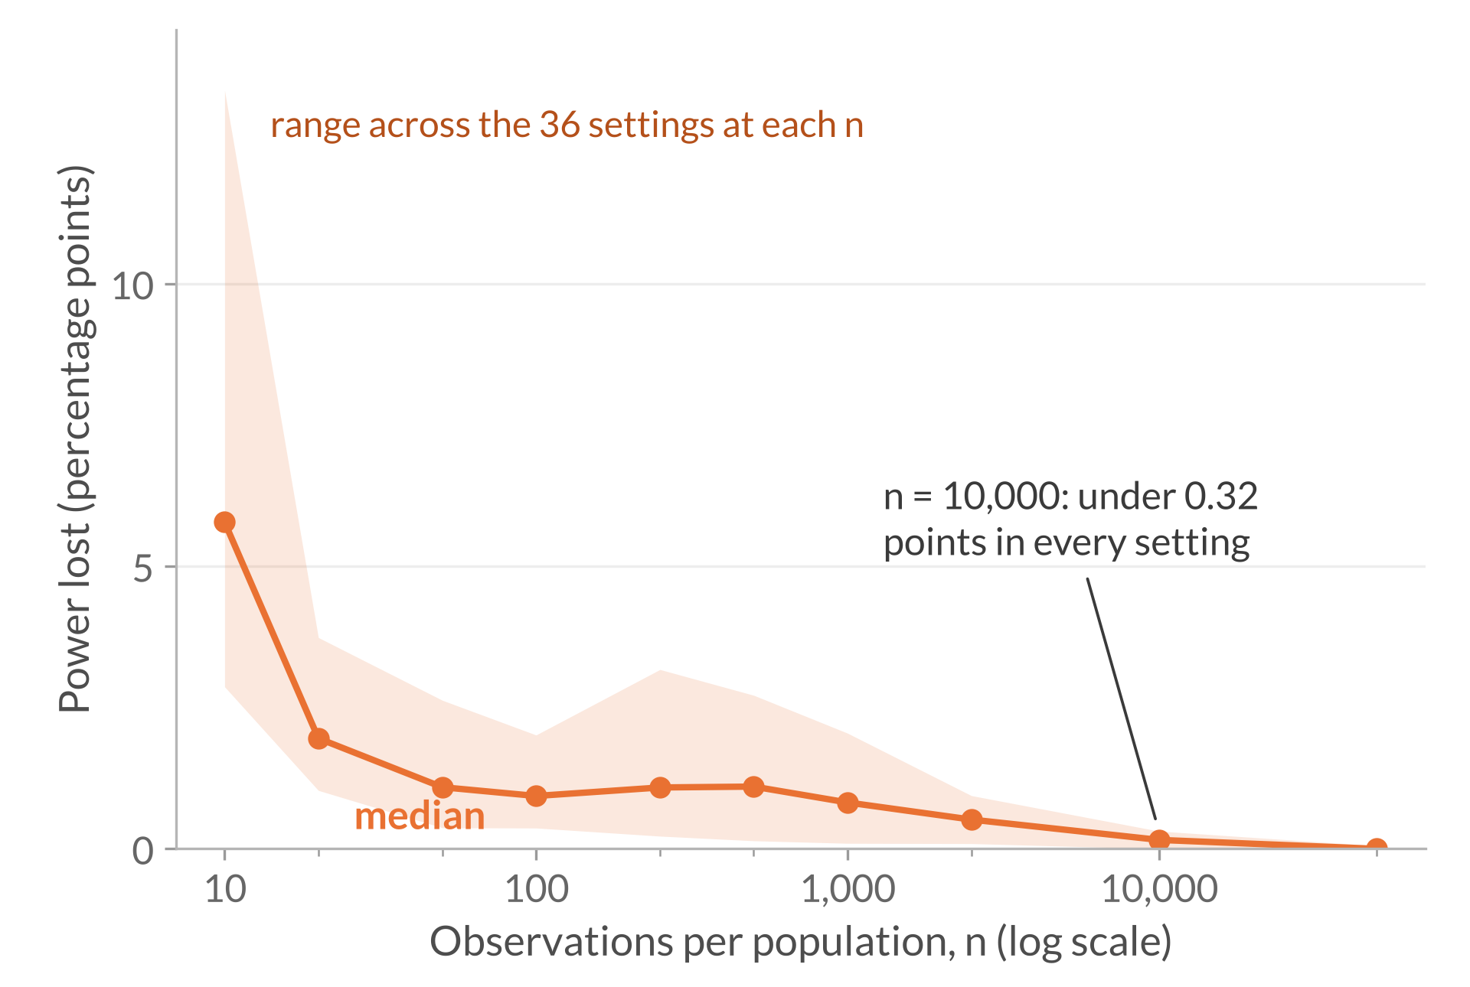
RQ3 results: the power cost of the larger cutoff
Expanded Welch never has more power than Wald;
the loss is largest in small samples and under 0.32 points by n = 10,000.
All 360 power settings · MI in P = 0.02 nats · gaps of 0.005, 0.01, and 0.02 nats
The loss is concentrated in small samples
Median loss: about 6 points at n = 10, about 1 point from n = 50 to 1,000, and 0.16 at n = 10,000. Failed calculations add to it at the smallest samples.
Small MI gaps can stay hard to detect
Even at n = 50,000, the 0.005 gap reaches only 79.87%–96.47% power; gaps of 0.01 and 0.02 exceed 99.9%.
Power: rejecting equal MI when population MI differs, in either direction, at the usual 0.05 threshold.
Power lost: Wald power minus Expanded Welch power, in percentage points.
Tallies of the thesis power study (Sections 6.3.1–6.3.3, Figures 6.7–6.9); unsuccessful calculations count as non-rejections. Full grids in B10–B12
11
Notes:
Time: 1:30 (finish by 15:50)
SCRIPT
Power is the probability of rejecting equal MI when the population MI values differ. Population P has MI 0.02 nats, and Q is larger by 0.005, 0.01, or 0.02. This chart covers all 360 power settings. For each sample size, it shows how many percentage points of power Expanded Welch gives up relative to Wald. The line is the median across the 36 settings. The shading is the full range across settings, not Monte Carlo uncertainty like the bands on earlier slides.
Expanded Welch never has more power, because its rejections are a subset of Wald's. The loss is largest at ten observations: a median of about six points, and up to thirteen, where failed calculations also contribute. From fifty to a thousand observations it is about one point, and by ten thousand it is under a third of a point in every setting.
Small gaps can stay hard to detect even with large samples. With fifty thousand observations, the smallest gap reaches only 80 to 96 percent power, while the two larger gaps exceed 99.9 percent. These rates count rejections in either direction, which matters for the next slide.
TRANSITION
“Different residual biases can make that directional error dominate the apparent detections.”
DELIVERY CUE
Pause when the graph appears. Say what “power lost” means before describing the shape, and that the shading is a range across settings. Read the medians, not the band edges. Do not call this matched-size power.
SOURCE
Thesis Sections 6.3.1–6.3.3, Figures 6.7–6.9, and Section 7.1.3; tallies of the MI-gap power rates (360 settings, both methods, all repetitions). Median loss 5.78 points at n = 10 (maximum 13.42); maximum 0.313 points at n = 10,000.

Slide 12
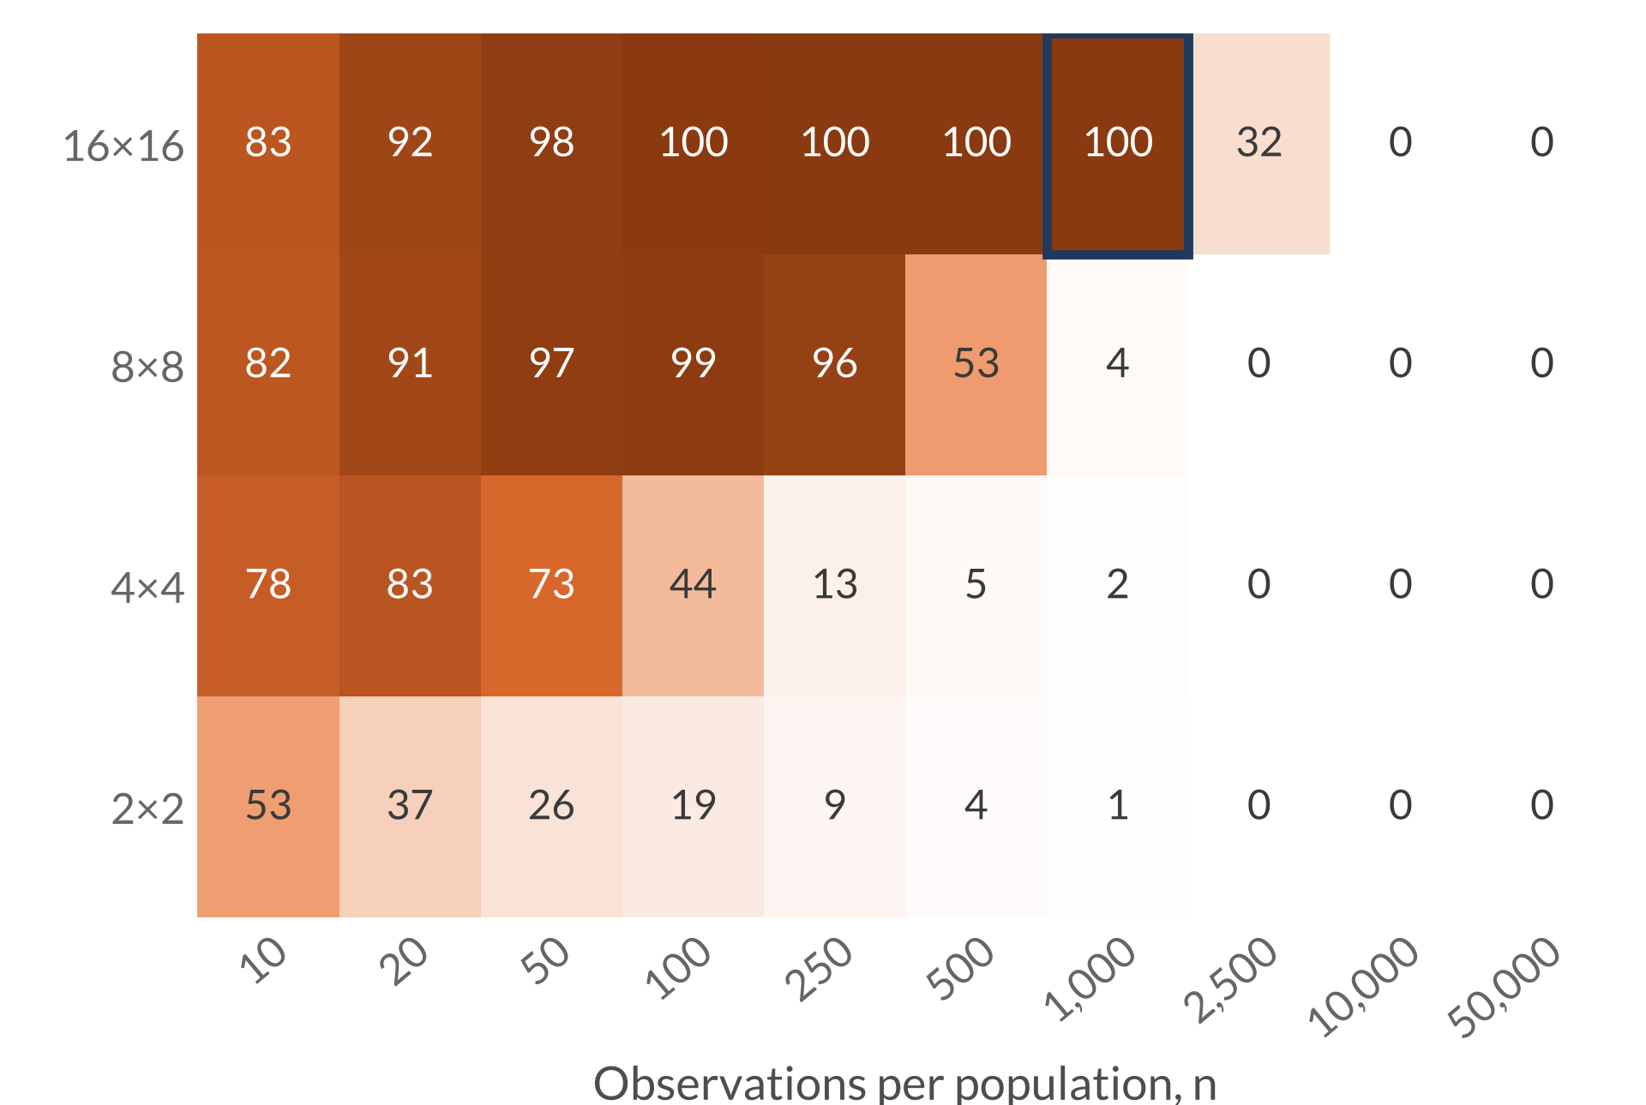
RQ3 results: bias can reverse the estimated direction
Under different-skew margins, sparse tables give rejections that point to the wrong population.
Different-skew margins · MI gap 0.01 nats · % of Expanded Welch rejections with the wrong sign
Outlined cell: 16×16, n = 1,000
True difference −0.0100 nats; mean estimate +0.0207. Expanded Welch rejects in 9.66% of repetitions, and over 99.9% of those point the wrong way.
Bias outweighs the gap
A larger cutoff cannot remove bias; more data can. By n = 10,000, under 0.4% of rejections point the wrong way.
All 360 power settings: at least 90% wrong in 28, all with different-skew margins.
Percentages are rounded. A value of 50% means half the rejections have the wrong estimated sign.
Tallies of the thesis power-study diagnostics (Section 6.3.3, Figure 6.9); other gaps show the same pattern. Outlined cell: 9,659 of 9,662 rejections positive
12
Notes:
Time: 2:00 (finish by 17:50)
SCRIPT
This heat map covers every table size and sample size under different-skew margins, for the 0.01-nat gap. Q always has the greater MI. Each cell shows the percentage of Expanded Welch rejections whose estimated difference points the other way, saying P has the greater MI. The percentages are rounded: fifty means half the rejections have the wrong sign, and a cell showing one hundred can still contain a few correct ones.
In the 8-by-8 and 16-by-16 tables, from fifty observations up to several hundred, almost every rejection points the wrong way. The outlined cell is the example from the thesis. The true difference is minus 0.01 nats, but the mean estimated difference is about plus 0.0207. Expanded Welch rejects in 9.66 percent of repetitions, and more than 99.9 percent of those rejections are positive.
The unequal margins give the two MI estimates different residual biases, and here the bias outweighs the true gap. A larger cutoff cannot remove that bias; it only changes how often we reject. More data does: by ten thousand observations, under 0.4 percent of rejections point the wrong way.
Across all 360 power settings, at least 90 percent of rejections point the wrong way in 28, all with different-skew margins. Two-sided power counts these as detections, but they fail to identify which population has greater MI.
TRANSITION
“The contribution and the remaining estimation problems lead to specific next steps.”
DELIVERY CUE
Pause when the heat map appears. Explain what a cell means before reading any number. Then the outlined cell's signed numbers, then pause. Preserve this slide in every shorter route. Every calculation succeeds at the outlined cell.
SOURCE
Thesis Section 6.3.3 and Figure 6.9; signed rejection counts in the MI-gap power diagnostics (360 settings). Outlined cell: 9,659 of 9,662 Expanded Welch rejections positive; bias about 0.0307 nats.

Slide 13
Conclusions and next steps
MI-specific degrees of freedom improve some false-positive rates, while remaining failures identify estimation accuracy as a priority.
Contribution and findings
1
2
3
Derived variance sensitivity and
MI-specific degrees of freedom.
Helped only where Wald rejected
too often; pushed conservative
settings further below 5%.
At the same nominal 5% threshold,
power is no higher; bias can make
rejections point the wrong way.
Scope: The evaluation covers one population construction and equal sample sizes, with the Wald test as the main benchmark.
Next steps
Reduce bias in the estimated MI difference and
improve its standard error and degrees of freedom,
including near independence.
Test other association constructions
and unequal sample sizes.
1
2
Thank you.
13
Notes:
Time: 1:00 (finish by 18:50)
SCRIPT
I derived the MI-specific variance sensitivity and used it to calculate degrees of freedom for a Welch–Satterthwaite comparison. Its larger cutoff brings some excessive false-positive rates closer to five percent, but also increases conservatism and reduces power under the usual rules.
The sparse-table examples show why the estimates remain central: a cutoff adjustment leaves bias and errors in the standard error unchanged, and bias can reverse the estimated direction. The evaluation covers one population construction and equal sample sizes, with the Wald test as the main benchmark. The next steps are to improve those estimates, retain additional sampling variation near independence, and evaluate broader population constructions and unequal sample sizes. The project contributes both the calculation and evidence identifying where it needs further development. Thank you.
DELIVERY CUE
Give contribution and boundary equal emphasis. Face the audience and keep this page visible for questions.
SOURCE
Final abstract; thesis Sections 1.3 and 7.1–7.3. No claim of universal superiority or validated independence-specific replacement test.
BACKUP INDEX (type the slide number, press Enter, then return to 13)
14 Appendix title
15 B1 Variance sensitivity
16 B2 Moment matching and combined degrees of freedom
17 B3 Population construction, grid, and calculation requirements
18 B4 Approximation ratios across table sizes
19 B5 Near-independence noise calculation
20 B6 Full null results: uniform margins
21 B7 Full null results: same-skew margins
22 B8 Full null results: different-skew margins
23 B9 Ordinary Welch degrees of freedom
24 B10 Full power results: uniform margins
25 B11 Full power results: same-skew margins
26 B12 Full power results: different-skew margins
27 B13 References: MI and testing foundations
28 B14 References: related methods and evaluation

Slide 14
Appendix
14
Notes:
Appendix title. Not part of the timed talk.
DELIVERY
No timed speech. Keep the conclusion on Slide 13 visible when questions begin, then open the relevant backup when needed and return to Slide 13 afterwards. The divider adds no time to the 18:50 main talk.

Slide 15
Variance sensitivity
Backup B1
Perturbation towards one cell:
$$P_{ε}=\left(1−ε\right)P+εδ_{\left(x,y\right)}$$
Changing probability weights
$$g_{P}\left(x,y\right)=\{ℓ_{P}\left(x,y\right)−I\left(P\right)\}^{2}−V\left(P\right)$$
Changing pointwise-MI values and margins
$$+2[ℓ_{P}\left(x,y\right)−E_{P}\{ℓ_{P}\left(X,Y\right)∣X=x\}$$
$$−E_{P}\{ℓ_{P}\left(X,Y\right)∣Y=y\}+I\left(P\right)]$$
Pointwise MI:
$$ℓ_{P}\left(i,j\right)=log\{p_{ij}/\left(p_{i+}p_{+j}\right)\}$$
Sensitivity variance:
$$τ^{2}\left(P\right)={Var}_{P}\{g_{P}\left(X,Y\right)\}$$
Exact for positive population tables; its use for sampling errors is first order. Thesis Chapter 4
15
Notes:
Not part of the timed talk. Return to Slide 13 afterwards.
QUESTION ANSWERED
What exactly did you differentiate, and where do the margin terms enter?
ANSWER TO GIVE
“I differentiate the pointwise-MI variance along a one-observation perturbation. The first part changes the probability weights. The bracket also changes the log ratios, including their row and column margins. Both contributions are necessary because the pointwise-MI values themselves depend on the table.”
NOTES
Assumptions: fixed categories, independent observations within each sample, independent samples, positive population cell probabilities, and positive V and tau-squared for the first-order degrees-of-freedom construction. With every cell positive, positive MI is equivalent to positive V (Appendix A.3), but positive V does not guarantee positive tau-squared. A zero component is not an ordinary finite degrees-of-freedom value.
SOURCE
Thesis Chapter 4: perturbation path (eq:contamination-path), final form of g (eq:g-final), and definition of tau-squared (eq:tau-definition). This derivative is exact for positive population tables. Its use for sampling errors is first order.

Slide 16
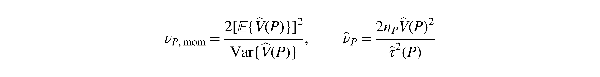
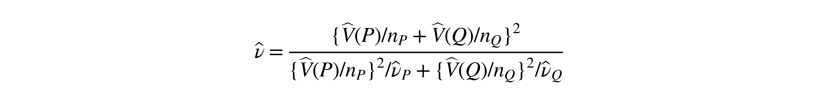
Moment matching and combined degrees of freedom
Backup B2
Component degrees of freedom
$$ν_{P,mom}=\frac{2{\left[E\{\hat{V}\left(P\right)\}\right]}^{2}}{Var\{\hat{V}\left(P\right)\}}, {\hat{ν}}_{P}=\frac{2n_{P}\hat{V}{\left(P\right)}^{2}}{{\hat{τ}}^{2}\left(P\right)}$$
Combined degrees of freedom
$$\hat{ν}=\frac{\{\hat{V}\left(P\right)/n_{P}+\hat{V}\left(Q\right)/n_{Q}\}^{2}}{\{\hat{V}\left(P\right)/n_{P}\}^{2}/{\hat{ν}}_{P}+\{\hat{V}\left(Q\right)/n_{Q}\}^{2}/{\hat{ν}}_{Q}}$$
Moment matching does not establish the standard normal numerator, or its independence from the variance estimates,
that an exact Student t distribution requires.
Satterthwaite (1946). Thesis Sections 4.1 and 4.3
16
Notes:
Not part of the timed talk. Return to Slide 13 afterwards.
QUESTION ANSWERED
Where do the component and combined df formulas come from, and why is the Student t distribution approximate?
ANSWER TO GIVE
“A variable with a scaled chi-squared distribution has variance twice its squared mean divided by its degrees of freedom. Matching those two moments gives the target. Dividing V-hat by fixed sample size rescales the squared mean and variance equally, so it leaves the component target unchanged. Independence between the two samples lets their variance contributions add. The resulting Student t distribution still requires empirical assessment.”
NOTES
For a generic variance estimate U modelled as c times a variable with a chi-squared distribution on ν degrees of freedom, E(U)=cν and Var(U)=2c²ν, giving ν=2[E(U)]²/Var(U). Scaling by fixed n leaves this ratio unchanged. For the Slide 7 example at n=1,000, first-order component df are 15.30 against the moment target 21.03: approximately (1/1.19)²/0.97=0.73. This explains the squared-mean effect without another main-slide formula.
SOURCE
Thesis Sections 4.1 and 4.3, pp. 23–36; Satterthwaite (1946).

Slide 17
Population construction, grid, and calculation requirements
Backup B3
$$p_{ij}\left(λ\right)=\left(1−λ\right)a_{i}a_{j}+λa_{i}1\{i=j\}, 0≤λ<1$$
Parameter grid
Calculation requirements and rates
k = 2, 4, 8, 16; uniform, same-skew, or different-skew margins
Same skew: both use 𝑚_{𝑘}(0.8). Different skew: P uses 𝑚_{𝑘}(0.7), Q uses 𝑚_{𝑘}(0.8), where 𝑚_{𝑘}(𝜌) = (𝜌, (1 − 𝜌)/(𝑘 − 1), …)
Null: shared MI 0.005, 0.02, 0.30. Power: 𝐼(𝑃) = 0.02; 𝐼(𝑄) = 0.025, 0.03, 0.04
Each null or power study has 360 settings,
100,000 independent pairs per setting
A Wald calculation needs a finite difference and a positive finite standard error. Expanded Welch also needs positive finite degrees of freedom.
Rate = rejections from successful calculations / all repetitions. Calculation success is reported separately.
n = 10, 20, 50, 100, 250, 500, 1,000, 2,500, 10,000, 50,000 per group
Thesis Chapter 5 and Appendix B.1–B.5
17
Notes:
Not part of the timed talk. Return to Slide 13 afterwards.
QUESTION ANSWERED
How are known-MI populations generated and degenerate calculations handled?
ANSWER TO GIVE
“The copying probability changes association while preserving chosen margins. I solve it separately for each target MI. Unsuccessful calculations count as non-rejections, so the rate measures the complete procedure; calculation success is reported separately. Conditioning on success would describe a selected subset of sampled tables.”
NOTES
Full requirements (Appendix B.3): a Wald calculation succeeds when it has a finite corrected difference, a finite positive standard error, V-hat(P) + V-hat(Q) > 10^-14, and a finite p-value. The Expanded Welch calculation additionally requires positive finite component and combined degrees of freedom and a finite p-value; if either component fails, the Expanded Welch calculation is unsuccessful. If a sampled table has V-hat = tau-hat-squared = 0, the component formula requires 0/0, so the Expanded Welch calculation is unsuccessful even if the other table makes the shared standard error positive and finite. Zero and undefined component degrees of freedom are distinct cases; both fail the positive-finite requirement. A failed calculation is not evidence of equality.
Sampling is independent within and between populations, and both methods receive identical sampled pairs. The construction uses the same vector for row and column margins within each population and is one association family, not all categorical distributions.
SOURCE
Thesis Chapter 5 and Appendix B.1–B.5; current grid results.

Slide 18
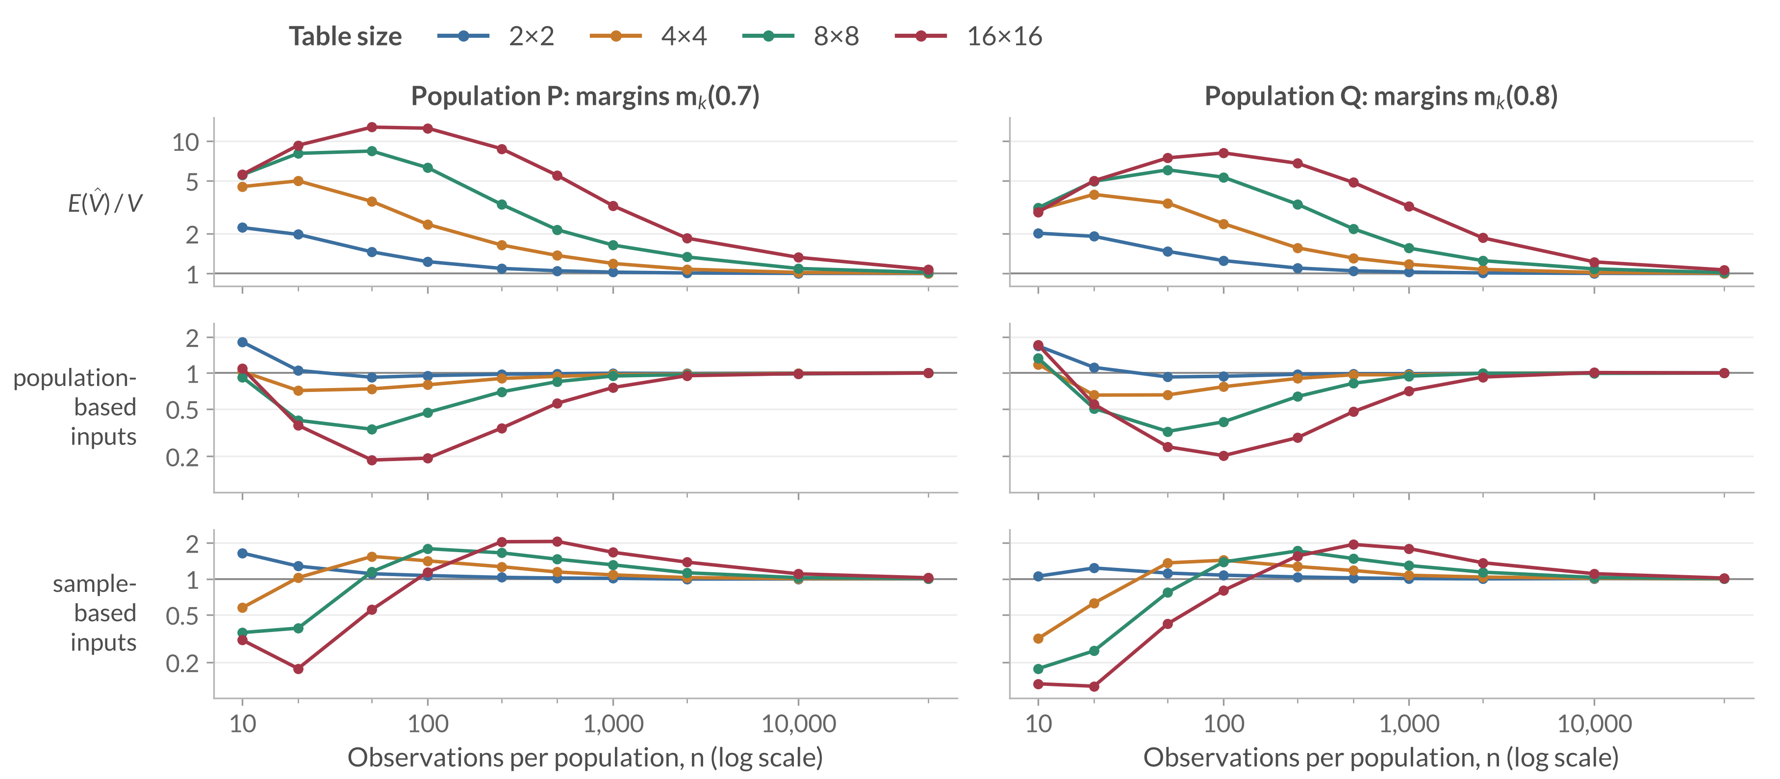
Approximation ratios across table sizes
Backup B4
Different-skew margins, shared MI 0.02 nats; a ratio of one indicates agreement
Rows: mean of 𝑉̂ / 𝑉; population-based and sample-based variance predictions / observed variance. Thesis Figure 6.1
18
Notes:
Not part of the timed talk. Return to Slide 13 afterwards.
WHEN OPENING
Colour now identifies table size; the rows are three different ratios.
QUESTION ANSWERED
Is the 4×4 example representative of other sizes and both populations?
ANSWER TO GIVE
“The larger tables generally have higher mean peaks, deeper population-variance troughs, and slower recovery in this family. Sample substitution can overpredict even while population inputs underpredict. The main slide isolates one slice so these quantities can first be understood separately.”
NOTES
Figure 6.2 separately checks how those moment errors affect df. In the worked 4×4/n=1,000 case, FO/target is about 0.73 and the exact values are 15.30/21.03; B2 explains why. Do not infer the mean of estimated df by inserting mean inputs into a nonlinear ratio. Full current Figure 6.2 remains in the thesis; it is not needed as another timed slide.
SOURCE
Sections 6.1.1–6.1.2, Figures 6.1–6.2, and current moments.csv; expected 80 rows: 4 sizes × 10 sample sizes × 2 populations.

Slide 19
Near-independence noise calculation
Backup B5
Setting: 4×4, n = 1,000, MI 0.0001; 𝑑 = 9 and 𝜅 = 2𝑛𝐼(𝑃) ≈ 0.2
$$G=2n\hat{I}\left(P\right) \dot{∼} χ_{d}^{2}\left(κ\right), {\hat{ν}}_{P}≈G/2$$
In 𝐺, 𝐼̂(𝑃) is the uncorrected plug-in MI, not a bias-corrected estimate.
Quantity | Local prediction | Observed (P)
Sample-based estimate (mean component df) | 4.60 | 4.86
Target (from sampling moments) | 9.00 | 9.12
Mean sample-based variance prediction / observed sampling variance | 1.96 | 1.97
Local approximations under fixed dimensions and positive limiting cell probabilities. Thesis Appendix A.2, Section 6.1.3
19
Notes:
Not part of the timed talk. Return to Slide 13 afterwards.
QUESTION ANSWERED
Why do the mean estimated df remain near five?
ANSWER TO GIVE
“Near independence, sampling noise creates apparent association. The quadratic likelihood-ratio approximation includes that noise. Substitution into the component formula gives roughly G divided by two, whose mean is about 4.6 in this setting. The population first-order formula instead approaches n times population MI. These are different approximations, which explains their separation.”
NOTES
Formulas: mean estimated component df (d + kappa)/2 = 4.60; sampling-moment target (d + kappa)^2/(d + 2 kappa) = 9.00; variance-prediction ratio 2(d + kappa)/(d + 2 kappa) = 1.96. The observed column is population P. The model predicts 9.00 for the target; it does not predict the observed 9.12 exactly.
SOURCE
Thesis Appendix A.2 and Section 6.1.3; Figure 6.3. These are local approximations under fixed dimensions and positive limiting cell probabilities, not exact finite-sample distribution identities.

Slide 20

Full null results: uniform margins
Backup B6
Equal MI in P and Q; uniform margins in both populations
Rates divide rejections by all 100,000 repetitions; unsuccessful calculations count as non-rejections. Requirements in B3. Thesis Figure 6.4
20
Notes:
Not part of the timed talk. Return to Slide 13 afterwards.
WHEN OPENING
Colours here identify the shared MI, not the method: solid lines with filled circles are the Wald test, dashed lines with open squares are the Expanded Welch test. Lower strips show calculation success.
QUESTION ANSWERED
What happens outside the highlighted different-skew 16×16 example?
ANSWER TO GIVE
“Under the copying construction, equal MI and uniform margins give identical population tables. Their expected MI biases cancel in the difference, but errors in the uncertainty estimate and reference distribution can still cause excessive or conservative rejection. Increasing shared MI changes those patterns.”
NOTES
All 120 settings for the uniform profile. Slide 9 plots each setting here as one point; its 8.35% to 4.90% example is the 4×4, n = 20, MI 0.02 setting.
SOURCE
Final Figure 6.4 and balanced-null combined rates, uniform profile. This page contains all 120 settings for that profile.

Slide 21

Full null results: same-skew margins
Backup B7
Equal MI; same-skew margins m_{k}(0.8) in P and Q
Rates divide rejections by all 100,000 repetitions; unsuccessful calculations count as non-rejections. Requirements in B3. Thesis Figure 6.5
21
Notes:
Not part of the timed talk. Return to Slide 13 afterwards.
WHEN OPENING
Colours here identify the shared MI, not the method: solid lines with filled circles are the Wald test, dashed lines with open squares are the Expanded Welch test. Lower strips show calculation success.
QUESTION ANSWERED
What changes when both populations have the same uneven category frequencies?
ANSWER TO GIVE
“The population tables are still identical under equal MI, so expected bias in the difference cancels. Uneven margins leave more rare category combinations. The conservative ranges persist beyond the smallest samples and are not explained solely by calculation failures. Expanded Welch lowers those already-low rates further.”
NOTES
All 120 settings for the same-skew profile.
SOURCE
Final Figure 6.5 and balanced-null combined rates, same-skew profile. This page contains all 120 settings for that profile.

Slide 22

Full null results: different-skew margins
Backup B8
Equal MI; m_{k}(0.7) in P and m_{k}(0.8) in Q
Rates divide rejections by all 100,000 repetitions; unsuccessful calculations count as non-rejections. Requirements in B3. Thesis Figure 6.6
22
Notes:
Not part of the timed talk. Return to Slide 13 afterwards.
WHEN OPENING
Colours here identify the shared MI, not the method: solid lines with filled circles are the Wald test, dashed lines with open squares are the Expanded Welch test. Lower strips show calculation success.
QUESTION ANSWERED
Are the severe failures restricted to the largest table, and what is visible over the complete margin-specific grid?
ANSWER TO GIVE
“Here equal MI permits different population tables. The remaining MI biases need not cancel, and in the sparse largest table they can shift the estimated difference substantially away from zero. The smaller-table patterns and the dependence on shared MI remain visible in this complete slice of the null grid.”
NOTES
All 120 settings for the different-skew profile. The Slide 10 diagnostic table uses the MI 0.02, n = 1,000 slice of these populations.
Additional anchor: At MI .005, n=1,000, and 16×16, Wald is 36.38% and Expanded Welch 34.38%, with every calculation successful in both tests. This is a different shared-MI level from the diagnostic table's .02; do not interchange the numbers.
SOURCE
Final Figure 6.6 and balanced-null combined rates, different-skew profile. This page contains all 120 settings for that profile.

Slide 23
Ordinary Welch degrees of freedom
Backup B9
Same statistic and sampled pairs; ordinary Welch gives each component 𝑛 − 1 degrees of freedom; shared MI 0.02 nats
Setting | Wald | Ordinary Welch | Expanded Welch
Uniform 4×4, n = 20 | 8.35% | 7.35% | 4.90%
Uniform 4×4, n = 50 | 4.87% | 4.57% | 3.24%
Different skew 16×16, n = 1,000 | 26.01% | 25.95% | 24.84%
False-positive rates; nominal target 5%.
n = 20
Ordinary Welch reduces the excess less than Expanded Welch.
n = 50
Wald is already close to 5%; Expanded Welch is the most conservative.
Different skew 16×16
Neither choice removes the excess caused by bias.
Conclusion: MI-specific degrees of freedom change the results,
but a larger reduction in rejection does not consistently improve calibration.
Same 100,000 sampled pairs per setting as the null study; every calculation succeeds. Thesis Section 6.2.5, Table 6.2
23
Notes:
Not part of the timed talk. Return to Slide 13 afterwards.
QUESTION ANSWERED
Would ordinary Welch degrees of freedom work as well as the MI-specific calculation?
ANSWER TO GIVE
“Ordinary Welch keeps the same estimated MI difference, standard error, and statistic, but gives each component n minus one degrees of freedom, the rule for comparing sample means. For MI that is only a benchmark, because it ignores how the pointwise-MI variance estimate changes with the table. At n = 20 it removes less of the excess than Expanded Welch. At n = 50, where Wald is already close to 5%, Expanded Welch becomes the most conservative. In the biased 16×16 case neither choice removes the excess. So the MI-specific calculation changes the results, but a larger reduction in rejection does not consistently improve calibration.”
NOTES
The three settings reuse the main null study's 100,000 sampled pairs per setting at shared MI 0.02 nats with n_P = n_Q = n; all three methods' calculations succeed in every repetition. The thesis examines ordinary Welch only at these illustrative settings and lists this as a limitation (Section 7.2); the main comparison is with the Wald test.
SOURCE
Thesis Section 6.2.5, Table 6.2; Section 7.2.

Slide 24

Full power results: uniform margins
Backup B10
Uniform margins; MI in P = 0.02 nats
Rates divide rejections by all 100,000 repetitions; unsuccessful calculations count as non-rejections. Requirements in B3. Thesis Figure 6.7
24
Notes:
Not part of the timed talk. Return to Slide 13 afterwards.
WHEN OPENING
Colours here identify the MI gap, not the method: solid lines with filled circles are the Wald test, dashed lines with open squares are the Expanded Welch test. Lower strips show calculation success.
QUESTION ANSWERED
Do the gap and sample-size patterns hold outside the single curve and snapshot?
ANSWER TO GIVE
“The complete uniform-margin grid shows the increase in detection with sufficient observations and the stronger-gap advantage. Larger tables need more data. Expanded Welch never exceeds Wald under the usual thresholds, with method differences becoming small at larger sample sizes.”
NOTES
120 settings, 240 method rows for this margin profile.
SOURCE
Section 6.3.1, Figure 6.7; power rates, profile=uniform, denominator=all. At n=10,000 and gap=.01, EW is 89.44% for 2×2 and 71.12% for 16×16. These values describe the stated population family.

Slide 25

Full power results: same-skew margins
Backup B11
Same-skew margins m_{k}(0.8) in P and Q; MI in P = 0.02 nats
Rates divide rejections by all 100,000 repetitions; unsuccessful calculations count as non-rejections. Requirements in B3. Thesis Figure 6.8
25
Notes:
Not part of the timed talk. Return to Slide 13 afterwards.
WHEN OPENING
Colours here identify the MI gap, not the method: solid lines with filled circles are the Wald test, dashed lines with open squares are the Expanded Welch test. Lower strips show calculation success.
QUESTION ANSWERED
Do the power patterns also occur when both groups have the same uneven margins?
ANSWER TO GIVE
“These power curves use the same uneven margins in both populations. Larger tables need more observations, and the smaller MI gap remains harder to detect. For example, at n=50,000, the 16×16 Expanded Welch power is 79.87% for the smallest gap, compared with more than 99.9% for each of the two larger gaps. The method difference is smaller than these gap and setting effects at larger sample sizes.”
NOTES
All 120 settings for the same-skew power profile.
SOURCE
Final Figure 6.8; Section 6.3.2; MI-gap combined rates, same-skew profile. This page contains all 120 settings for that profile.

Slide 26

Full power results: different-skew margins
Backup B12
m_{k}(0.7) in P, m_{k}(0.8) in Q; MI in P = 0.02 nats
Rates divide rejections by all 100,000 repetitions; unsuccessful calculations count as non-rejections. Requirements in B3. Thesis Figure 6.9
26
Notes:
Not part of the timed talk. Return to Slide 13 afterwards.
WHEN OPENING
Colours here identify the MI gap, not the method: solid lines with filled circles are the Wald test, dashed lines with open squares are the Expanded Welch test. Lower strips show calculation success.
QUESTION ANSWERED
How does the bias-related failure vary with gap and table size?
ANSWER TO GIVE
“Unequal residual biases can shift the estimated difference opposite to its true sign. The two-sided rate includes those rejections. As the bias shrinks, rejection can first fall and later recover. Gap size and margins therefore affect power through the estimator's behaviour as well as the true separation.”
NOTES
120 settings, 240 method rows. The main point is 16×16, gap 0.01, n = 1,000.
At the main point the mean estimate is +.0206714 for true −.01. Of 9,662 EW rejections, 9,659 are positive and 3 negative. Do not apply that conditional percentage to the entire grid or all 100,000 estimates.
SOURCE
Section 6.3.3, Figure 6.9, and current power CSVs, profile=different_skew, denominator=all.

Slide 27
References: MI and testing foundations
Backup B13
Bossomaier, T., Barnett, L., Harré, M. and Lizier, J. T. (2016). An Introduction to Transfer Entropy: Information Flow in Complex Systems. Springer, Cham. doi:10.1007/978-3-319-43222-9
Moddemeijer, R. (1989). On estimation of entropy and mutual information of continuous distributions. Signal Processing, 16(3), 233–248. doi:10.1016/0165-1684(89)90132-1
Paninski, L. (2003). Estimation of entropy and mutual information. Neural Computation, 15(6), 1191–1253. doi:10.1162/089976603321780272
Mora, R. and Ruiz-Castillo, J. (2009). The statistical properties of the mutual information index of multigroup segregation. Working Paper, Economic Series (48), 09-84, Universidad Carlos III de Madrid, Departamento de Economía.
Satterthwaite, F. E. (1946). An approximate distribution of estimates of variance components. Biometrics Bulletin, 2(6), 110–114. doi:10.2307/3002019
Welch, B. L. (1947). The generalization of “Student’s” problem when several different population variances are involved. Biometrika, 34(1–2), 28–35. doi:10.1093/biomet/34.1-2.28
27
Notes:
Not part of the timed talk. Use this page if a source is requested. Entries follow the thesis bibliography.

Slide 28
References: related methods and evaluation
Backup B14
Hutcheson, K. (1970). A test for comparing diversities based on the Shannon formula. Journal of Theoretical Biology, 29(1), 151–154. doi:10.1016/0022-5193(70)90124-4
Morris, T. P., White, I. R. and Crowther, M. J. (2019). Using simulation studies to evaluate statistical methods. Statistics in Medicine, 38(11), 2074–2102. doi:10.1002/sim.8086
Pan, W. and Wall, M. M. (2002). Small-sample adjustments in using the sandwich variance estimator in generalized estimating equations. Statistics in Medicine, 21(10), 1429–1441. doi:10.1002/sim.1142
Wald, A. (1943). Tests of statistical hypotheses concerning several parameters when the number of observations is large. Transactions of the American Mathematical Society, 54(3), 426–482. doi:10.1090/S0002-9947-1943-0012401-3
28
Notes:
Not part of the timed talk. Use this page if a source is requested. Entries follow the thesis bibliography.

